Slide 1
Wireless Security

Slide 2
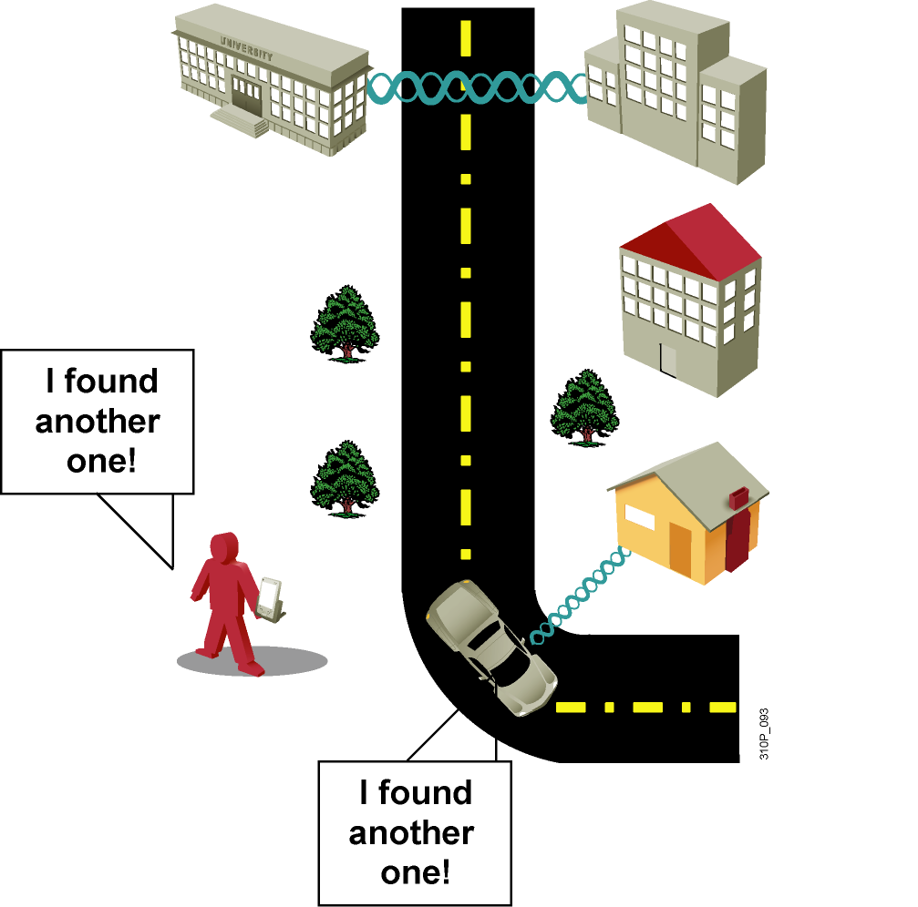
Why WLAN Security?
Wide availability and low cost of IEEE 802.11 wireless equipment
802.11 standard ease of use and deployment
Availability of sniffers
Statistics on WLAN security
Media hype about
hot spots, WLAN hacking,
war driving
Nonoptimal implementation of encryption in standard Wired Equivalent Privacy (WEP) encryption
Authentication vulnerability
Notes:
With the cost of 802.11b systems coming down it is inevitable that hackers will have a lot more unsecured WLANs to choose from.
802.11b “Sniffers” enable network engineers (and hackers) to passively capture data packets so they can be examined to correct system problems.
“War driving” is a phrase that describes someone who is using a cellular scanning device looking for cell phone numbers to exploit. Recently, the definition of war driving has been expanded to include someone driving around with their laptop and a 802.11b client card looking for an 802.11b system to exploit.
There have been vulnerabilities reported using numerous open source applications to collect & exploit vulnerabilities in the 802.11 standard security mechanism, WEP.
With basic WEP encryption (or obviously with no encryption) enabled, it is possible to collect data and obtain sensitive network information such as user login information, account numbers, personnel records, etc. etc.

Slide 3
Wireless Security Overview
A WLAN is open to anyone within range of an AP and the appropriate credentials to associate to it.
Attacks can be generated by outsiders, disgruntled employees, and even unintentionally by employees. Wireless networks are specifically susceptible to several threats, including the following:
Interception of data
Wireless intruders
Denial of Service (DoS) Attacks
Rogue APs

Slide 4
DoS Attacks
Wireless DoS attacks can be the result of the following:
Improperly configured devices
A malicious user intentionally interfering with the wireless communication
Accidental interference
To minimize the risk of a DoS attack due to improperly configured devices and malicious attacks, harden all devices, keep passwords secure, create backups, and ensure that all configuration changes are incorporated off-hours.

Slide 5
Rogue Access Points
A rogue AP is an AP or wireless router that has been connected to a corporate network without explicit authorization and against corporate policy.
Once connected, the rogue AP can be used by an attacker to capture MAC addresses, capture data packets, gain access to network resources, or launch a man-in-the-middle attack.
A personal network hotspot could also be used as a rogue AP. For example, a user with secure network access enables their authorized Windows host to become a Wi-Fi AP.
To prevent the installation of rogue APs, organizations must configure WLCs with rogue AP policies and use monitoring software to actively monitor the radio spectrum for unauthorized APs.

Slide 6
Man-in-the-Middle Attack
In a man-in-the-middle (MITM) attack, the hacker is positioned in between two legitimate entities in order to read or modify the data that passes between the two parties. A popular wireless MITM attack is called the “evil twin AP” attack, where an attacker introduces a rogue AP and configures it with the same SSID as a legitimate AP.
Defeating a MITM attack begins with identifying legitimate devices on the WLAN. To do this, users must be authenticated. After all of the legitimate devices are known, the network can be monitored for abnormal devices or traffic.

Slide 7
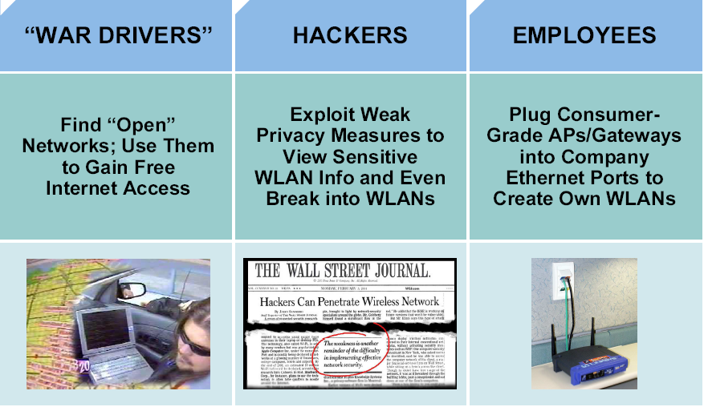
Wireless LAN Security Threats
Notes:
With the lower costs of IEEE 802.11b/g systems, it is inevitable that hackers will have many more unsecured WLANs from which to choose.
Incidents have been reported of people using numerous open source applications to collect and exploit vulnerabilities in the IEEE 802.11 standard security mechanism, Wired Equivalent Privacy (WEP).
Wireless sniffers enable network engineers to passively capture data packets so that they can be examined to correct system problems. These same sniffers can be used by hackers to exploit known security weaknesses.
“War driving” is a phrase that was originally used to describe someone who is using a cellular scanning device looking for cell phone numbers to exploit. War driving also refers to someone driving around with a laptop and an 802.11b/g client card looking for an 802.11b/g system to exploit.
Most wireless devices sold today are wireless network ready. End users often do not change default settings or they implement only standard WEP security, which is not optimal solution for secure wireless networks.
With basic WEP encryption enabled (or, obviously, with no encryption enabled), it is possible to collect data and obtain sensitive network information, such as user login information, account numbers, and personal records.
A rogue AP is an AP that has been placed on a WLAN and that might be used to interfere with normal network operations (DoS attacks, for example). If this rogue AP is programmed with the correct WEP key, client data may be captured. This AP may also be configured to provide unauthorized users with information about the network, such as MAC addresses of clients (both wireless and wired), the ability to capture and spoof data packets, and at worst, access to servers and files. A simple and common version of rogue AP are those employees unknowning install. Employees install access points intended for home use without the necessary security configuration on the enterprize network causing a security risk for the network.

Slide 8
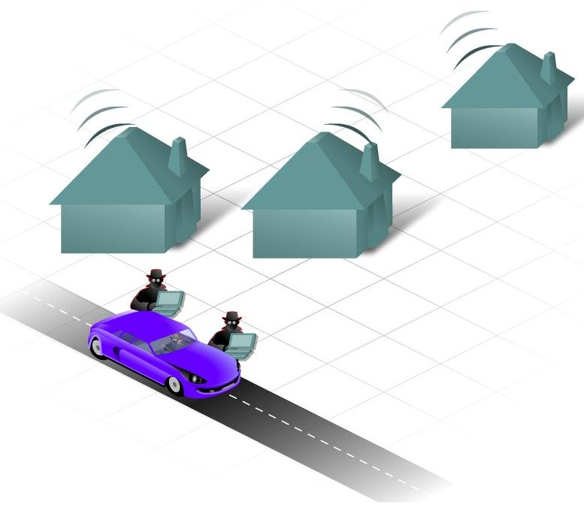
Wireless Security
No physical connection needed
Attacker can “tune into” your network just like tuning into a radio station
Easy access if all settings are set to default, so . . .
CHANGE THE SETTINGS
  disable SSID
  change default password
  change default IP
But . .
  SSID transmitted in clear text
  still possible to learn the SSID

Slide 9
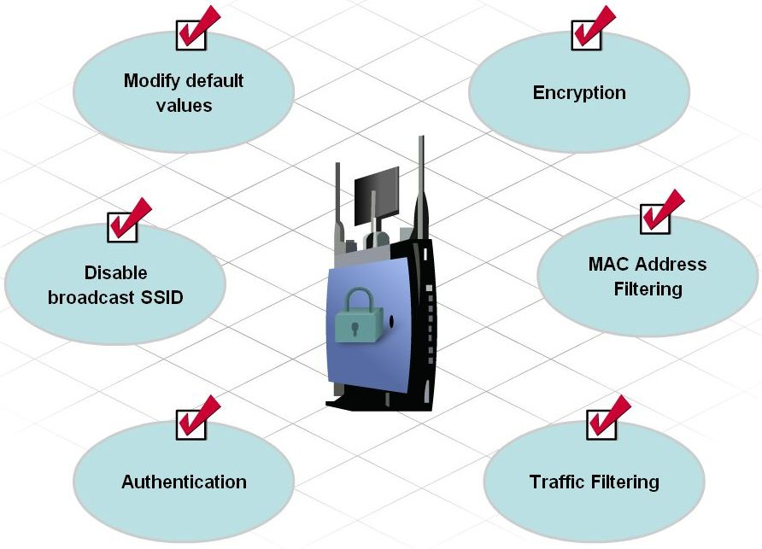
Securing the AP
Basic Security
  Changing values (SSID, usernames, passwords)
  Disable Broadcast SSID
  MAC Address filtering
Advanced Security
  Encryption
  Authentication
  Traffic Filtering

Slide 10
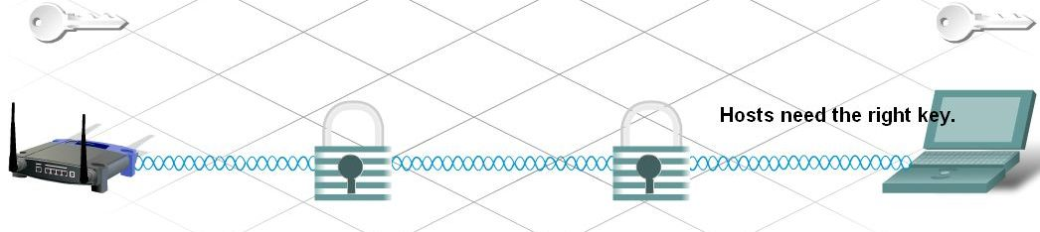
Encryption
Process of transforming data so if intercepted, will still be unusable
WEP (Wired Equivalency Protocol)
  advanced security feature
  encrypts network traffic as it travels
  64 – 128 bits (letters and/or numbers)
  AP and every device on the network must have the same WEP key

Slide 11
Evolution of Wireless LAN Security
1997
2001
2003
2004 to Present
WEP
802.1x EAP
WPA
802.11i / WPA2
  Basic encryption
  No strong authentication
  Static,
  breakable keys
  Not scalable
  MAC filters and SSID-cloaking also used to complement WEP
  Dynamic keys
  Improved encryption
  User authentication
  802.1X EAP (LEAP, PEAP)
  RADIUS
  Standardized
  Improved encryption
  Strong, user authentication (such as, LEAP, PEAP, EAP-FAST)
  AES strong encryption
  Authentication
  Dynamic key management
Notes:
The figure shows the evolution of wireless LAN (WLAN) security.
Initially, IEEE 802.11 security only defined 64-bit static WEP keys for both encryption and if used authentication. The 64-bit key contained the actual 40-bit key plus 24-bit Initialization Vector (IV). The authentication method was not strong and the keys were eventually compromised. Because the keys were administered statically, this method of security was not scalable to large enterprise environments. Enterprise companies tried to supplement this weakness with techniques using SSID and MAC address filtering.
The SSID is a network-naming scheme and configurable parameter that both the client and the AP must share. If the client does not have the proper SSID advertised from the access point configured to not broadcast the SSID (SSID Cloaking), it is unable to associate with the AP and would have no access to the network. The problem with the effort was that 802.11 allows wireless client to use a null string (no value entered into the SSID field) thereby requesting that the AP to broadcast its SSID rendering the security effort ineffective. Access point also supported filtering using a MAC address. Tables are manually constructed on the AP to allow or disallow clients based upon their physical hardware address. However MAC addresses may be relatively easily spoofed and MAC address filtering is not considered a security feature either.
While 802.11 committee then began the process of upgrading the security of the WLAN, Enterprise customers needed wireless security immediately to enable deployment. Driven by customer demand, Cisco introduced early proprietary enhancements to RC4-based WEP encryption. Cisco implemented Cisco’s Temporal Key Integrity Protocol (CKIP) per-packet keying or hashing and Cisco’s Message Integrity Check (CMIC) to protect WEP keys. Cisco also adapted the use of IEEE 802.1X wired authentication protocols on wireless and dynamic keys using Lightweight EAP (LEAP) to a centralized database.
Soon after Cisco wireless security implementation, the Wi-Fi Alliance introduced Wi-Fi Protected Access (WPA) as an interim solution that was a subset of the expected 802.11i security standard for WLANs using 802.1X authentication and improvements to WEP encryption. The newer key hashing (TKIP versus CKIP) and message integrity check (MIC versus CMIC) where similar in feature but not compatible.
Today IEEE 802.11i has been ratified and Advanced Encryption Standard (AES) has replaced Wired Equivalent Privacy (WEP) as the latest and most secure method of encrypting data. Wireless intrusion detection systems are available to identify and protect the WLAN from attacks. The Wi-Fi Alliance certifies 802.11i devices under Wi-Fi Protected Access 2 (WPA2).

Slide 12

Security – Authentication
Controls who connects to the network
Permitted based on set of credentials
Helps to verify the “trustworthiness” of the device
  usernames
  passwords
Occurs before client is connected to WLAN

Slide 13
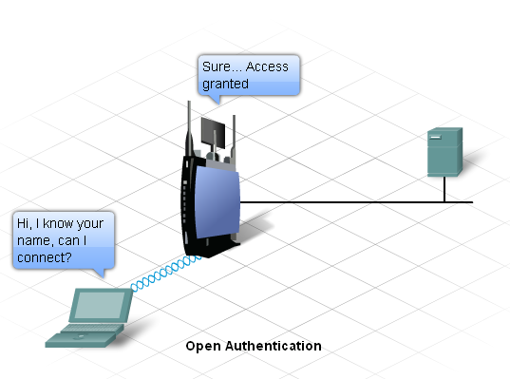
Open Authentication
On by default
Any and all clients can access AP
Should only be used on public wireless networks
  Schools
  Internet Café

Slide 14
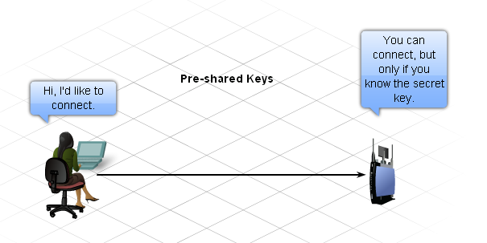
PSK (Pre-Shared Keys) Authentication
Both AP and client must have the same secret key or word
Here’s how it works:
  AP sends random string of bytes to client
  Client accepts it, encrypts it, and sends it back to AP
  AP receives encrypted string, decrypts it
  if decrypted string = original string → client is added

Slide 15
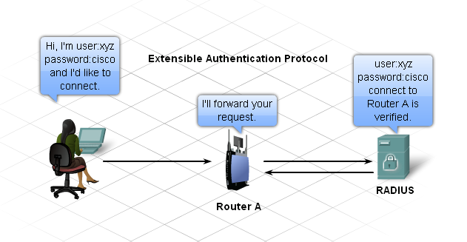
EAP (Extensible Authentication Protocol)
EAP software must be installed on the client device
Client talks with RADIUS Server
  Remote Authentication Dial-in User Services
  server functions separately from the AP
  server keeps a database of valid users
  username and password checked by the server

Slide 16
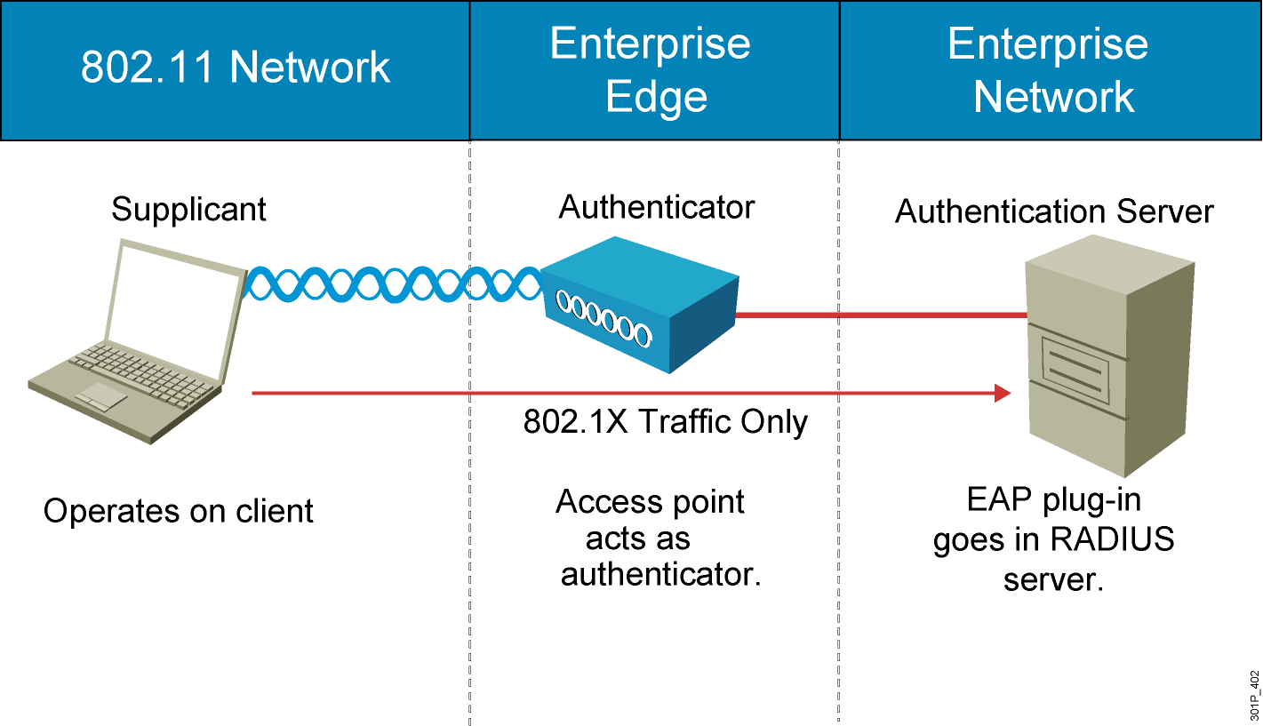
How 802.1X Works on the WLAN
Notes:
The access point, acting as the authenticator at the enterprise edge, allows the client to associate using open authentication. The access point then encapsulates any 802.1X traffic bound for the authentication server and sends it to the server. All other network traffic is blocked, meaning that all other attempts to access network resources are blocked.
Upon receiving RADIUS traffic bound for the client, the access point encapsulates it and sends the information to the client. Although the server authenticates the client as a valid network user, this process allows the client to validate the server as well, ensuring that the client is not logging into a phony server.
While an enterprise network will use a centralized authentication server, smaller offices or business might simply use the access point with preshared keys as the authentication server for wireless clients.

Slide 17
Traffic Filtering
Controls the type of traffic allowed across a WLAN
Able to block traffic based on:
  IP Address
  MAC Address
  Port Numbers

Slide 18
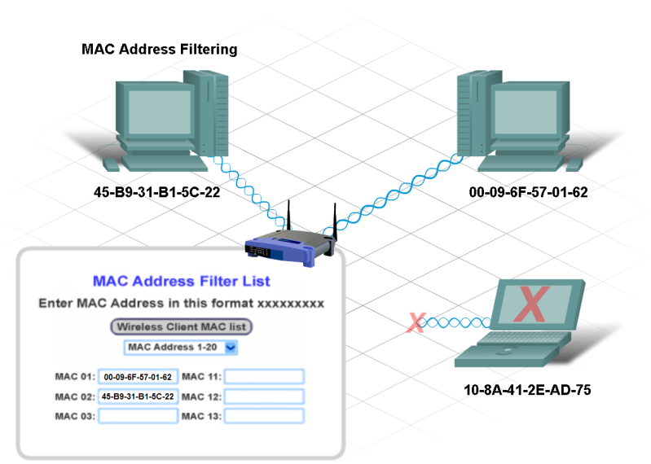
MAC Address Filtering
Another security feature
Will limit access to your network
MAC address used to identify which device can connect to the wireless network
  wireless AP looks up MAC in a list (database)
  only those addresses listed will gain access

Slide 19
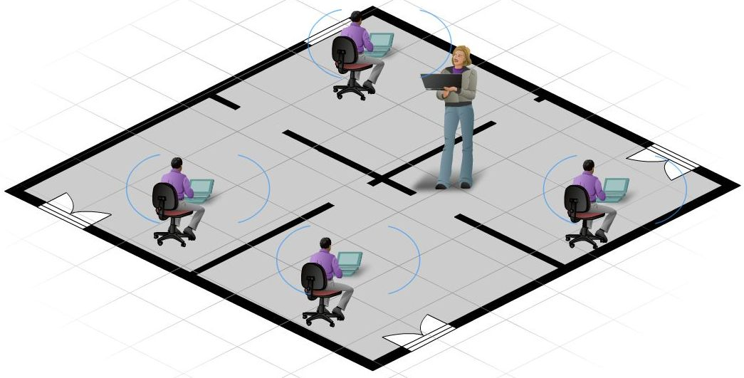
Planning the WLAN
Determine the type of wireless standard
  802.11b, g, n operates at 2.4 GHz
  travels farther than 5 GHz
  Less equipment = lower cost
Determine layout
  look at existing infrastructure
  if using 802.11a, will it work with the newest standards??
Installation/Security
  Total Cost of Ownership (TCO)
  Site Survey
    signal strength
    possible interference
Backup/Updating Devices

Slide 21
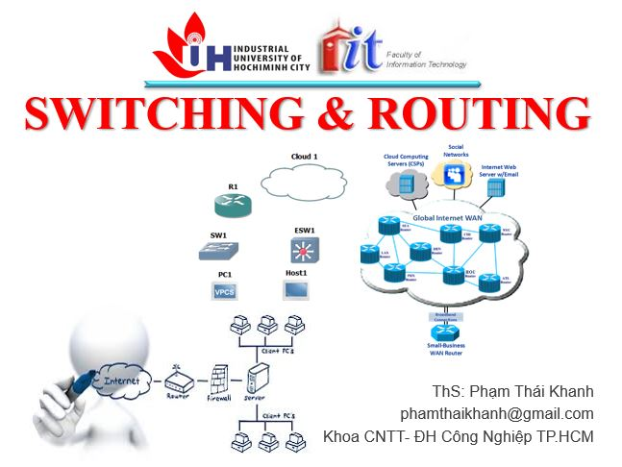


phamthaikhanh@gmail.com
This Photo by Unknown Author is licensed under CC BY-NC

